Slide 1
Experiments in cookie science
because science is delicious

Slide 2
background
what makes a cookie into a cookie?

Slide 3
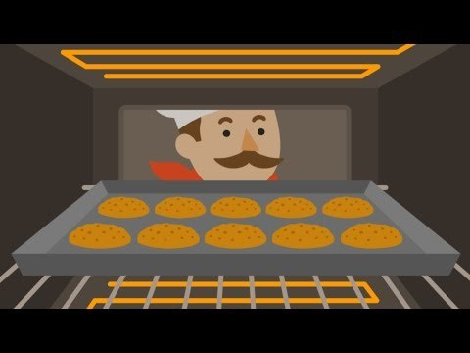

Slide 4
butter
PROCESS: butter warms up → cookie spreads out → edges of cookie thin out and cook
SCIENTIFIC PROPERTIES: butter is a fat. fats inhibit formation of stringy gluten protein network
HYPOTHESIS: butter makes cookies spread out more, and taste more “cakey” and less “chewy”
VARIATIONS: use extra butter, substitute shortening for butter, use melted butter

Slide 5
SUGAR
PROCESS 1: brown sugar (ACID) reacts with baking soda (BASE),
PROCESS 2: sugar granules get hot → maillard reaction and caramelization → browned and tasty
SCIENTIFIC PROPERTIES: sugar caramelizes at 365 f. brown sugar is an acid but white sugar is not.
HYPOTHESIS: with mostly brown sugar, the cookie will be softer and thicker (from baking soda reaction). with mostly white sugar, the cookie will be flatter and crisper.
VARIATIONS: use all white sugar, all brown sugar, or half and half.

Slide 6
FLOUR
PROCESS: proteins in flour react with eggs and sugar in maillard reaction
SCIENTIFIC PROPERTIES: flour contains gluten, a protein that makes things stick together. all-purpose or cake flour has less gluten protein than bread flour.
HYPOTHESIS: more bread flour = chewier cookie. More all-purpose/cake flour = softer cookie
VARIATIONS: substitute all-purpose flour for bread flour

Slide 7
EGGS
PROCESS: egg proteins heat up and denature → egg coagulates → cookie sticks together
SCIENTIFIC PROPERTIES: eggs contain lots of water, fat, and protein.
HYPOTHESIS: extra egg yolk makes chewier and softer cookies (less crumbly)
VARIATIONS: add 1 extra egg yolk to the dough

Slide 8
BAKING POWDER / BAKING SODA
PROCESS: acid+base react in water → co₂ and water try to escape → cookie rises and gets air pockets
SCIENTIFIC PROPERTIES: baking soda is a base. baking powder contains an acid and a base.
HYPOTHESIS: varying proportion of baking soda vs. powder will change the amount of puffiness
VARIATIONS: use just baking powder, just baking soda, or half and half

Slide 9
HEAT
PROCESS 1: in the oven: butter, sugar, flour, and eggs heat up and react at high temperatures
PROCESS 2: after baking: cookie cools down → liquid sugar hardens and air cools → cookie deflates and edges get crispy
SCIENTIFIC PROPERTIES: heat denatures proteins, evaporates water, and lets reactions occur

Slide 10
The Experiment
(it looks a lot like baking)

Slide 11
